Slide 1
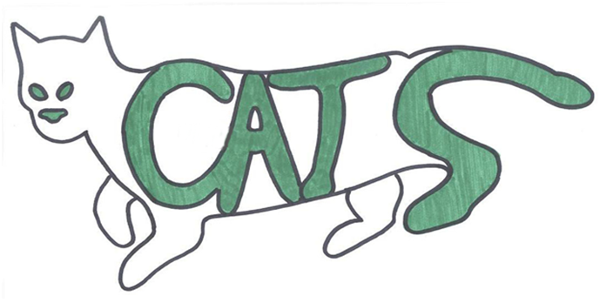
Capital Area
Tracking Services
Cody Clarke - Project Team Leader
Sherry Priddy - Project Assistant Team Leader
Jason Baker - Information Analyst
Les Stewart - Data Collection
Randy Guzman - Graphic Artist & Webmaster

Slide 2
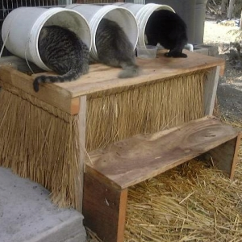
Background
Feral Cats are usually the offspring of a lost or abandoned cat.
To reduce populations, they are trapped, neutered/spayed and vaccinated by veterinarians and returned back to their home territory.
They are maintained through volunteer programs that feed and care for them.

Slide 3
Tracking of Feral Cat Colonies throughout Hays County
Capital Area Tracking Services (C.A.T.S.) will work together with San Marcos TNRM (Trap ~ Neuter ~ Release ~ Maintain) and its mother organization PALS (Pet Prevent A Litter of Central Texas) in order to create a comprehensive geodatabase and spatial information system that catalogs all feral cat colonies planted and maintained in Hay’s County by TNRM.

Slide 4
Purpose and Goals
This project will enable San Marcos TNRM to be more competitive in the search for federal grant money to help support their ongoing project and will accomplish two goals:
TNRM will meet compliance with City of San Marcos ordinance 6.017 Feral Cat Management, which mandates the tracking of feral cat colonies.
Will show where feral cat colonies are in regard to the local habitat and make future predictions of where new feral colonies may occur throughout the county.

Slide 5
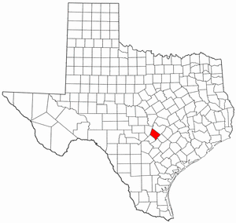
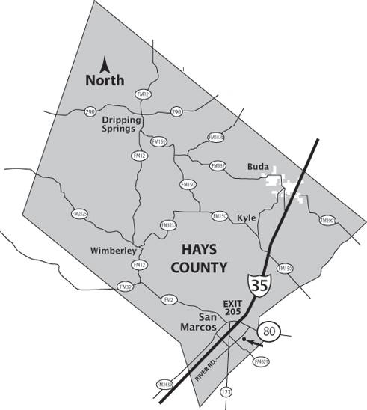
Objectives
Our objectives are to reference and plot feral cat colonies across Hay’s county and show the colony distribution across various types of land use.

Slide 6
Data Requisites
The data needed to perform and complete the initial analysis include:
A complete listing of all feral cats and their personal information
Location of the areas the feral cats have been both captured and released after being spayed or neutered.
The location of colonies
Data retrieved from the City of San Marcos

Slide 7
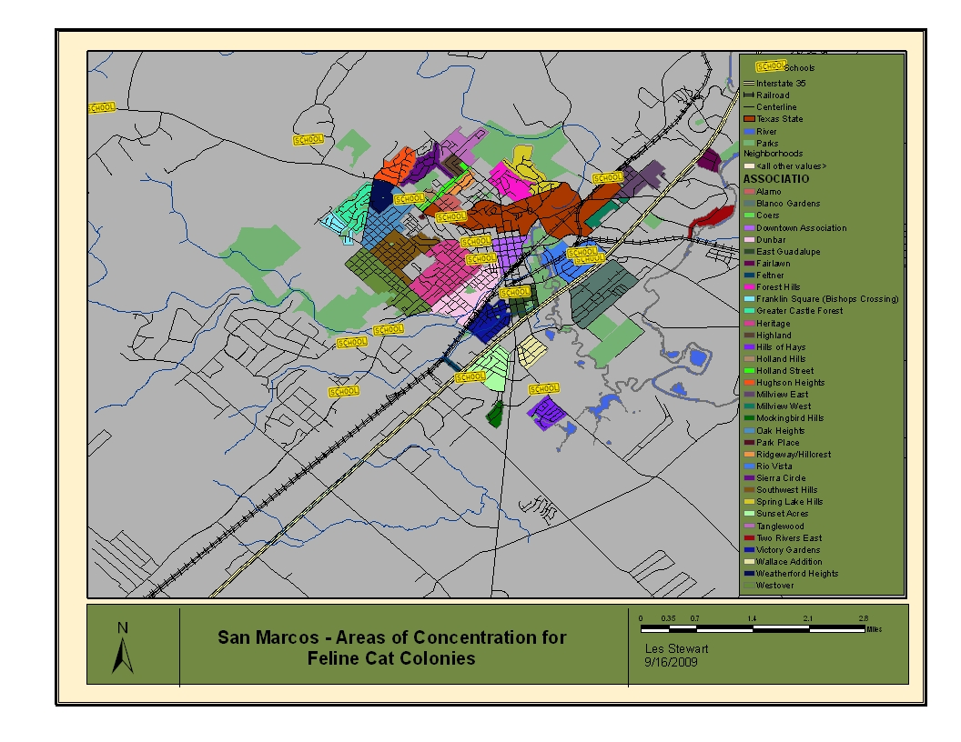
Preliminary Context Map

Slide 8
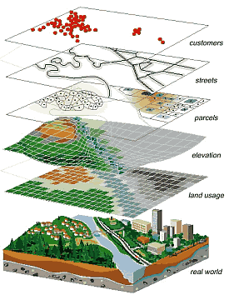
Methodology

Slide 9
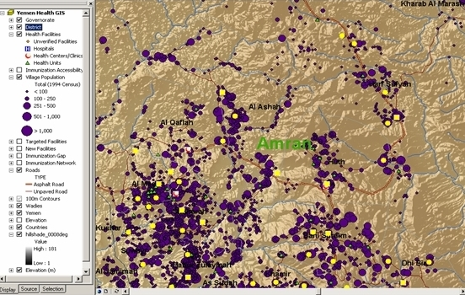
Methodology
To complete our objectives of digitally referencing, mapping out, and predicting new feral cat colonies across Hay’s County:
We must compile all feral cat and caretaker information into a single, formatted excel document.
With this information, we will create points in ArcGIS of all cat colonies. Points will be plotted based on an 'address locater.’
The roads, census tracts, municipal land use, and political boundaries will then be added to the map.
All spatial data will be presented in Hays County.

Slide 10
Methodology
1.5 mile circular areas will be created around each cat colony.
After the areas are created, a query will be performed finding municipal land use, population density based on census tracts, and average income based on census tracts within the 1.5 mile surrounding areas.
Trends regarding land use, average income, and population density surrounding each cat colony will be analyzed.
Data will be converted for analysis within ArcGIS

Slide 11
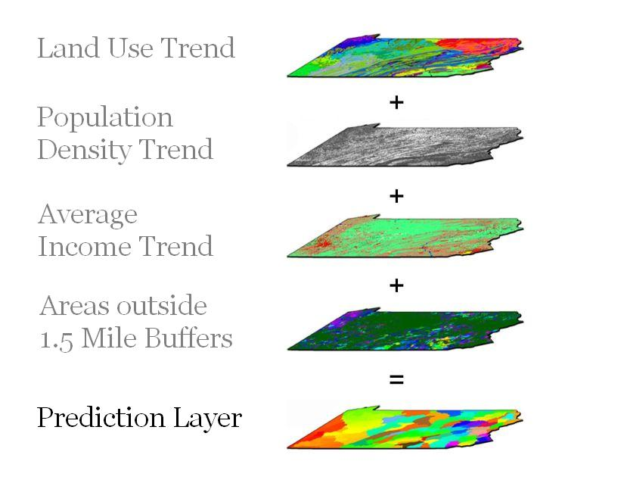
Methodology
The team will perform a spatial overlay analysis
A new, trend based layer is created and will predict where feral cat colonies may appear in the future.

Slide 12
Methodology
The team will then export feral cat colonies, buffers, and prediction trend layer to Google Earth with callout boxes including colony caretaker and number of cats.

Slide 13
TimeLine
9/21-10/7
Data Collection
10/21-11/25
Data Application
12/7
Presentation of Project
10/7-10/21
Data Interpretation
10/26
Progress Report Delivered
11/30
All Deliverables Ready for Presentation

Slide 14
Budget
This project has an estimated total cost of $18,666.
Approximately $7,950 of this will be from data collection and interpretation and data analysis.
Approximately $8,400 will be in management of the project and application process’.
The remaining cost of $2,316 is accrued from degradation of materials, traveling costs, and Web Development.

Slide 15
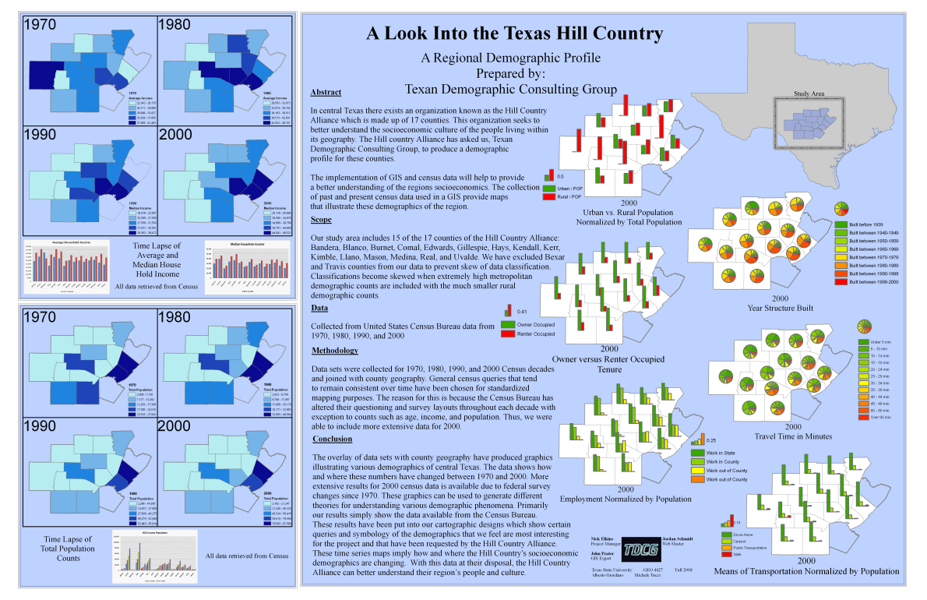
Final Deliverables
Report
Descriptive Maps
ArcGIS data
Metadata
Poster
Example ONLY. Past Project from Fall 2008 Advanced GIS II. Texas Demographics Consulting Group.
https://tracs.txstate.edu/portal/site/2771060b-a1b2-4c92-a946-c0e5bbd553ff

Slide 16
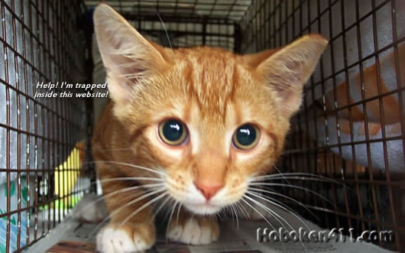
Conclusion
Continue the project TNRM began so that receiving grant money needed to fulfill its task will be easier to attain.

Slide 17
Questions?

